Slide 1
Quantitative Evaluation of LoRa for DoD Applications
University of California, San Diego (UCSD)
Master’s of Advance Study (MAS)
Wireless Embedded Systems
Bryce Rooney

Slide 2


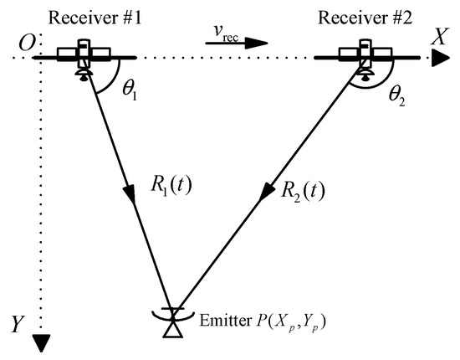
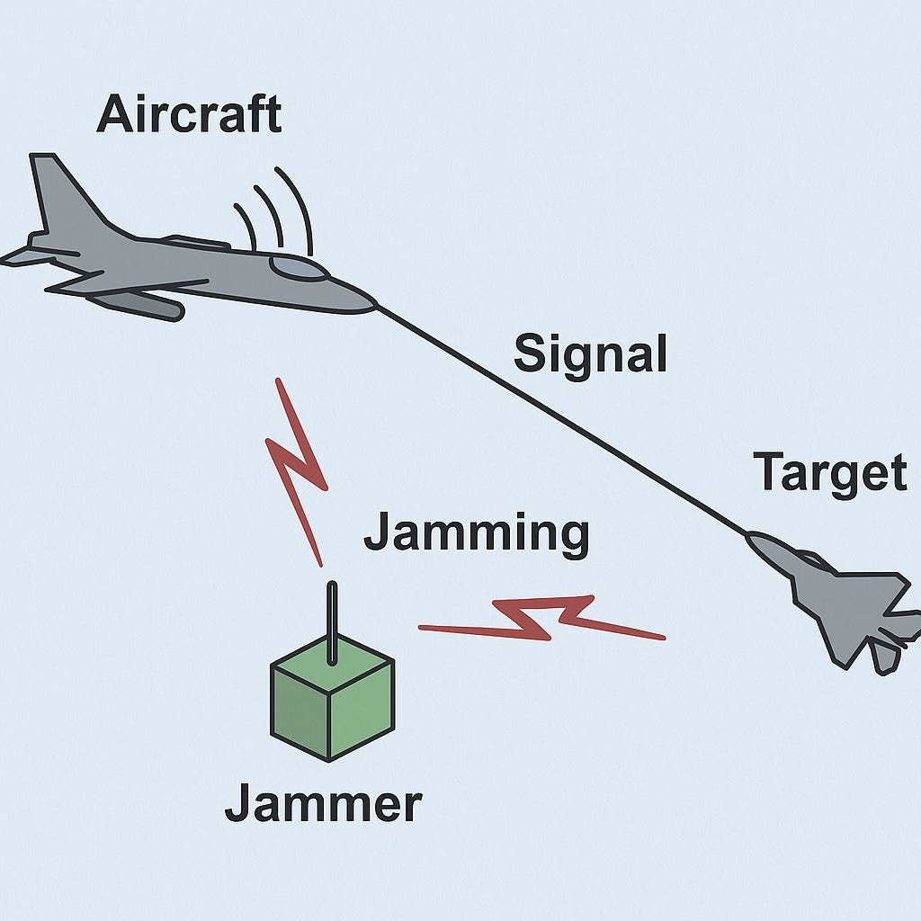
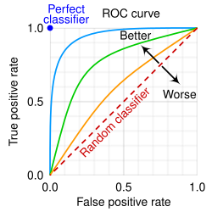
Resiliency, Detectability, and Geolocation of a Waveform
Collaboration with Naval Information Warfare Center, Pacific (NIWC Pac) Division 535
Resiliency – How well does a waveform perform in the presence of noise, interference and/or at range?
Detectability – How easy is the presence of the active waveform to detect?
Geolocation – How precise can a transmitter be located?
Detectability
Resiliency
Geolocation

Slide 3
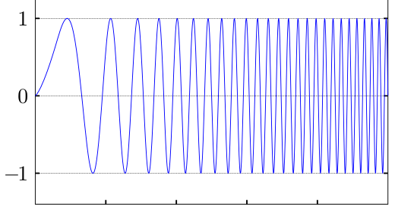
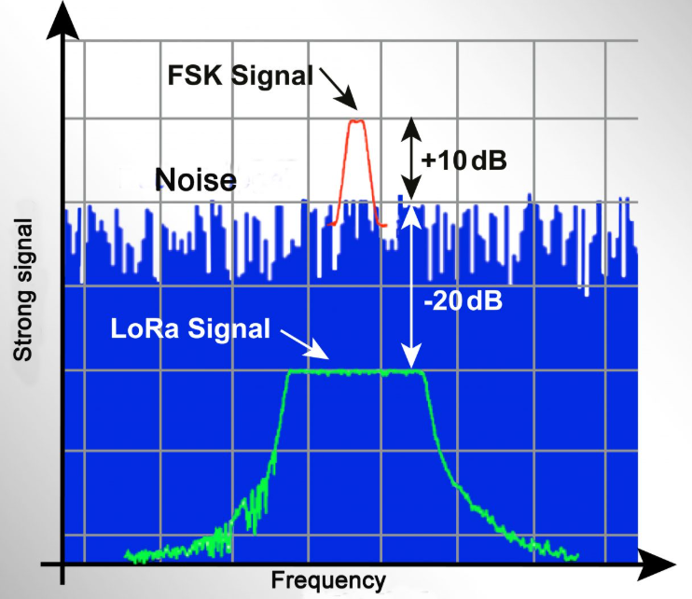
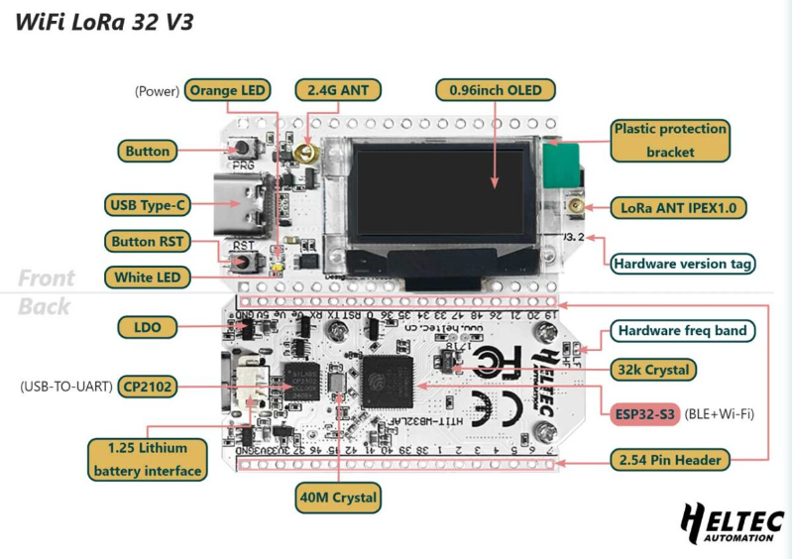
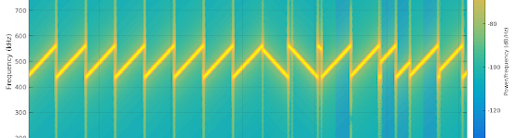
Long Range (LoRa) Chirp Spread Spectrum (CSS)
Proprietary modulation technique
Commercial Off-The-Shelf (COTS)
Extremely Low Cost, Size, and Power consumption
Heltec LoRa V3 dev board (Semtech SX1262)
Notes:
Proprietary modulation technique
Commercial Off-The-Shelf (COTS)
Extremely Low Cost, Size, and Power consumption
Modulation uses “Chirps” – linear sweeps in frequency
Receiver Sensitivity can be below thermal noise floor – valuable for range and resiliency performance
Heltec LoRa V3 dev board (Semtech SX1262)

Slide 4
Test Approach
Iterative testing against various LoRa Configurations
Spread Factor (SF) and Bandwidth (BW) variations
Scenario Defined
Gaussian Noise
Radiometry
Cross Ambiguity Function (CAF)
Scripts
Simulated environment
Limitations
Heltec/LoRa Code development
Available hardware
Scripts
Scenarios

Slide 5
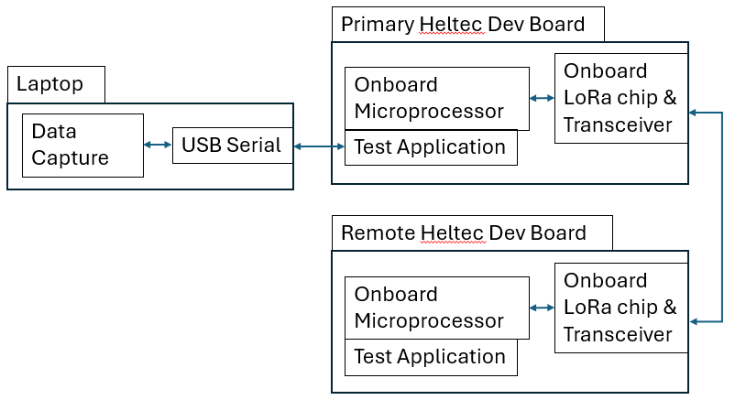
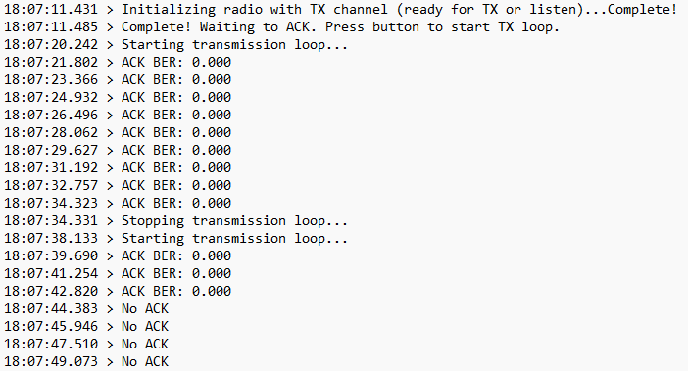
Development Efforts
LoRa development boards (Heltec LoRa V3)
Visual Studio Code C++
Platform IO extension
“Application” traffic exercises waveform signal
50B payload transmitted ~once per second
ACK/NACK between the two with output logging
Single code base for quick uploads between test configs
SF and BW inputs with dynamic protocol adjustment to minimize iterative testing
Code base works as ACK device or Tx device with button toggle
Notes:
Published results to find. Google scholar
Connected papers
This weekend.

Slide 6
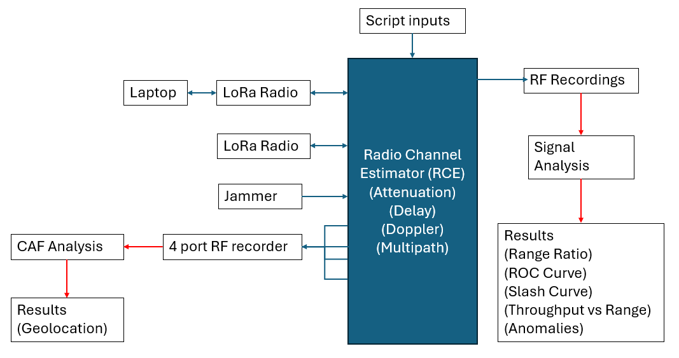
Test Bed and Equipment
Notes:
EW cert
RSSI values in ACK, SNR
Other values

Slide 7
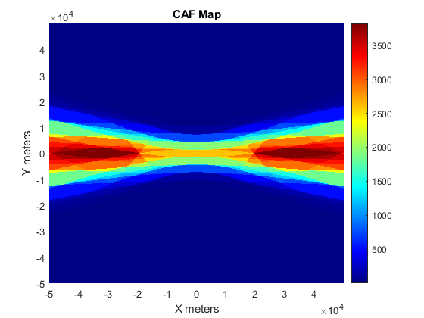
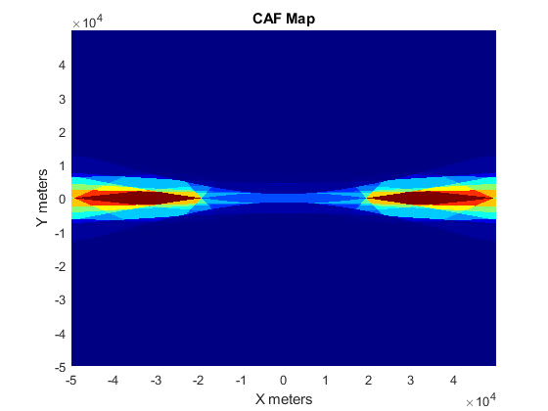
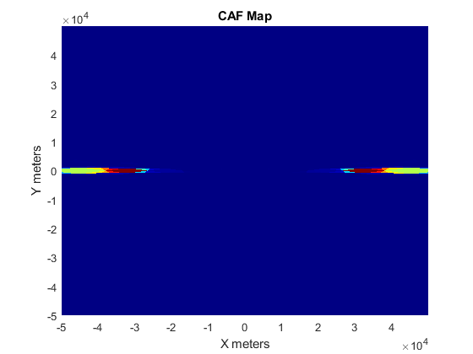
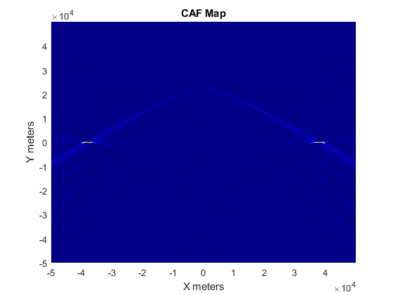
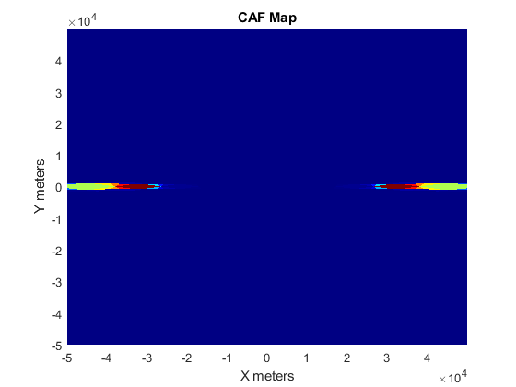
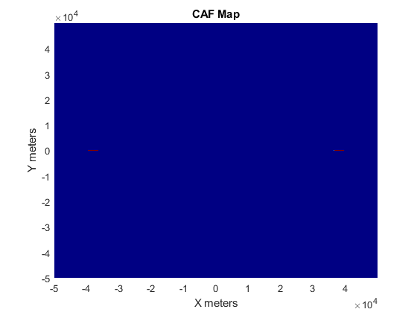
Geolocation Results (CAF)
Top SF 7
(Left-right) BW 10.4k, BW 20k, BW 125k, BW 500k
Bottom SF 12
(Left-right) BW 125k, BW 500k

Slide 8
Geolocation Analysis
Bandwidth | Peak Area (square km) | Effective Data Rate (SF 7)
10.4 kHz | ~ 80 | ~ 450 bps
20 kHz | ~ 75 | ~ 910 bps
125 kHz | ~ 5 | ~ 5,400 bps
500 kHz | <1 | ~ 21,000 bps
Detector Location
Transmitter location
Notes:
4 recorders, 6 2 point CAF outputs combined
No multipath

Slide 9
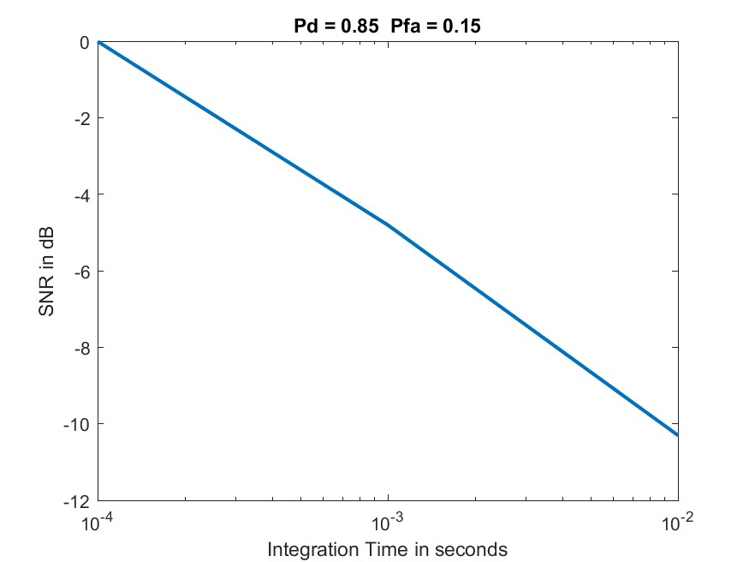
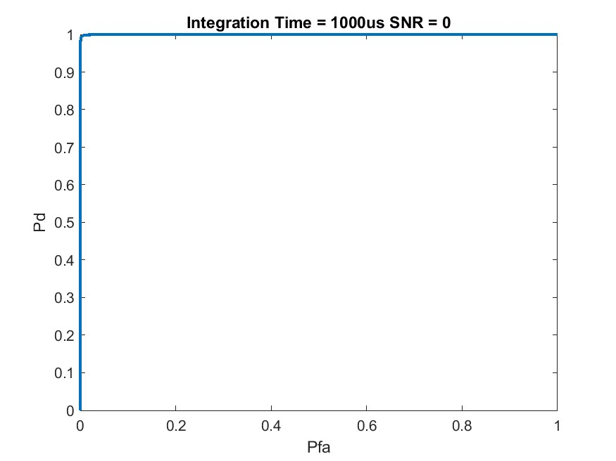
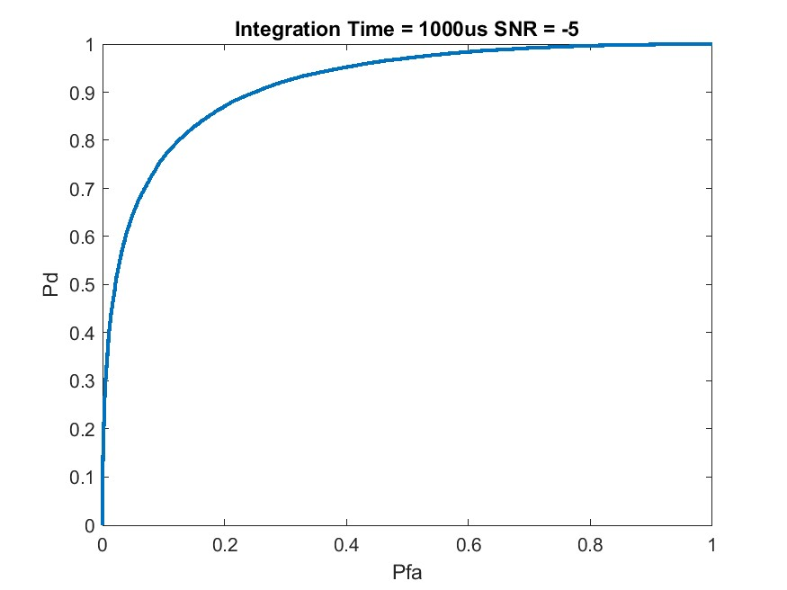
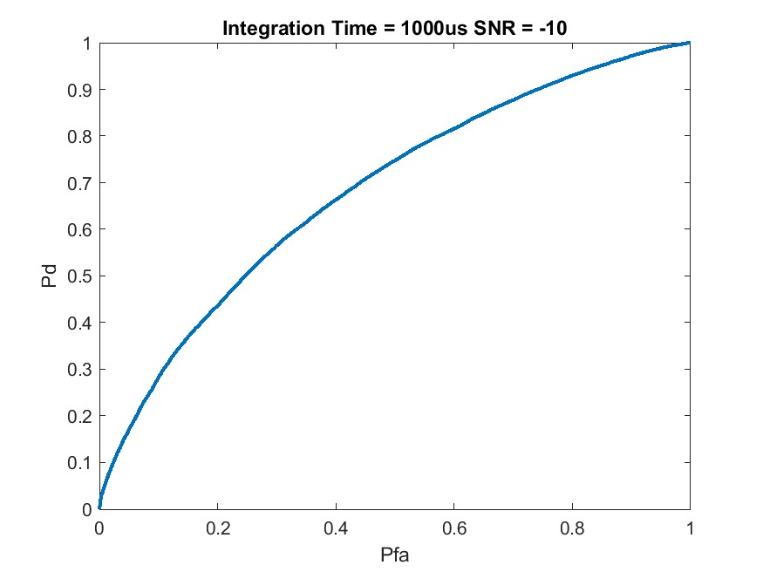
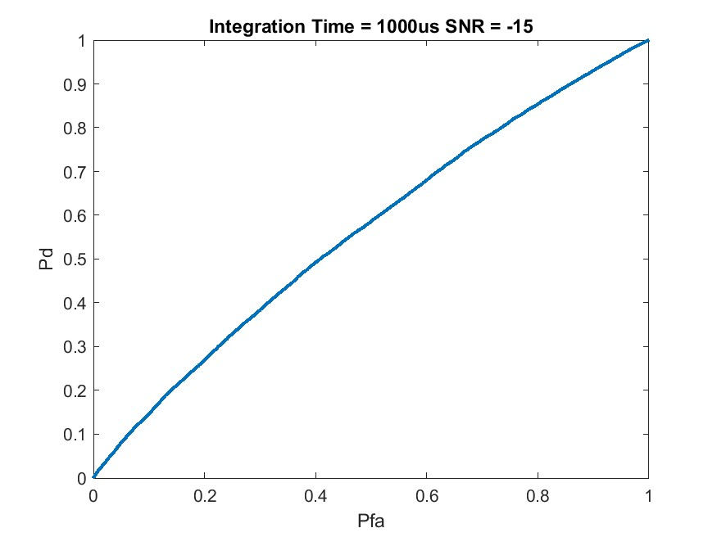
Probability of Detection Results
Slash Curve (Pd = .85)
Radiometry (energy-based detection)
Empirical Probability Calculations (MATLAB)
Receiver Operating Characteristic (ROC) Curve
Slash curve
ROC Perfect Classifier
ROC Near-Randon Classifier
SNR = 0 dB
SNR = -5 dB
SNR = -10 dB
SNR = -15 dB
Notes:
SF7 125k example

Slide 10
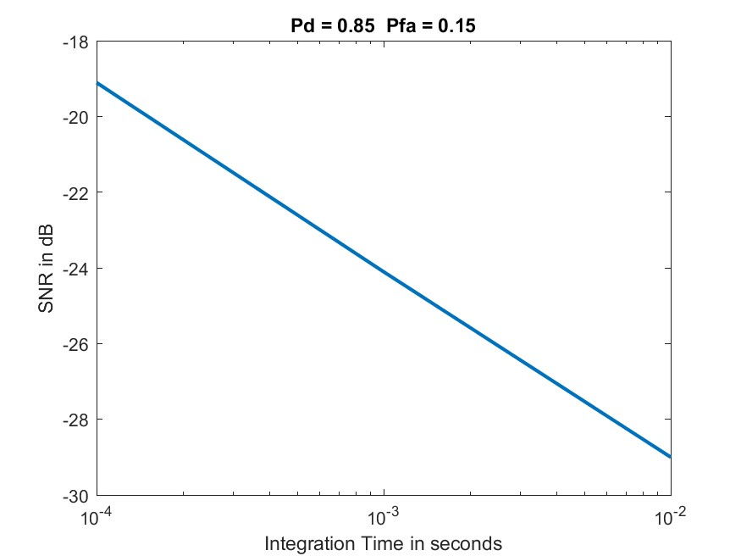
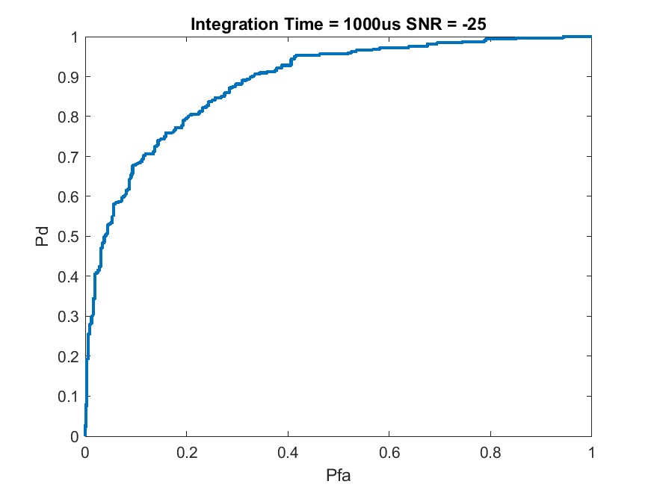
Detection Analysis
LoRa SF 7 BW 125kHz
Spread Factor | Bandwidth | SNR for .85/.15 (Pd/Pfa)
7 | 10.4 kHz | -5 dB
7 | 20 kHz | -5 dB
7 | 125 kHz | -7.5 dB
7 | 500 kHz | -10 dB
12 | 125 kHz | -7.5 dB
12 | 500 kHz | -10 dB
Comparison Waveform
Comparison Waveform = -25 dB SNR
Notes:
Independent of WF operation

Slide 11
Resiliency Results
Radiometry (energy-based detection)
Empirical Probability Calculations (MATLAB)
Receiver Operating Characteristic (ROC) Curve
Slash curve
Notes:
SF7 125k example

Slide 12
Resiliency Analysis
Comparison Waveform = -25 dB SNR
Notes:
Independent of WF operation

Slide 13
Conclusions
Comparison Waveform = -25 dB SNR
Notes:
Independent of WF operation

